Slide 1
SOLAR CELL
Some specific materials, which have certain properties such as bandgap ranging from 1 EV to 1.8 EV, high electrical conductivity, and high optical absorption, are required for the construction of solar cells.
Semiconductors such as Silicon, Gallium Arsenide, Copper Indium Selenide, Indium Phosphide, and Cadmium Telluride satisfies these conditions; hence they are generally used for constructing solar cells.
The antireflection layer is typically made of oxides of Titanium, Tantalum, or Silicon through the vacuum deposition process or spin coating.

Slide 2
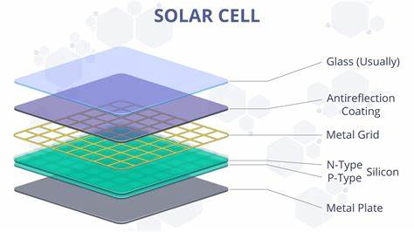
SOLAR CELL

Slide 3
SOLAR CELL
1. Glass Layer (Usually on Top)
Acts as a protective cover for the solar cell.
Transparent so light can enter.
Provides mechanical strength and environmental protection.
2. Antireflection Coating
Reduces reflection of light from the surface (otherwise ~30% sunlight is lost).
Allows more light to enter the silicon layer.
Usually made of silicon nitride (Si₃N₄) or titanium dioxide (TiO₂).
3. Metal Grid (Front Contact)
Thin metal lines (grid) collect electrons generated in the silicon layer.
Allows current to flow out while blocking minimal sunlight.
Typically made of silver or aluminum.

Slide 4
SOLAR CELL
4. Silicon Layer (N-Type and P-Type Silicon)
This is the active region where electricity is generated.
Together they form a p-n junction.
When sunlight hits the junction, electrons and holes separate, creating a voltage.
5. Metal Plate (Back Contact)
Acts as the rear electrical contact.
Collects electrons from the silicon and completes the circuit.
Also acts as a support base.

Slide 5
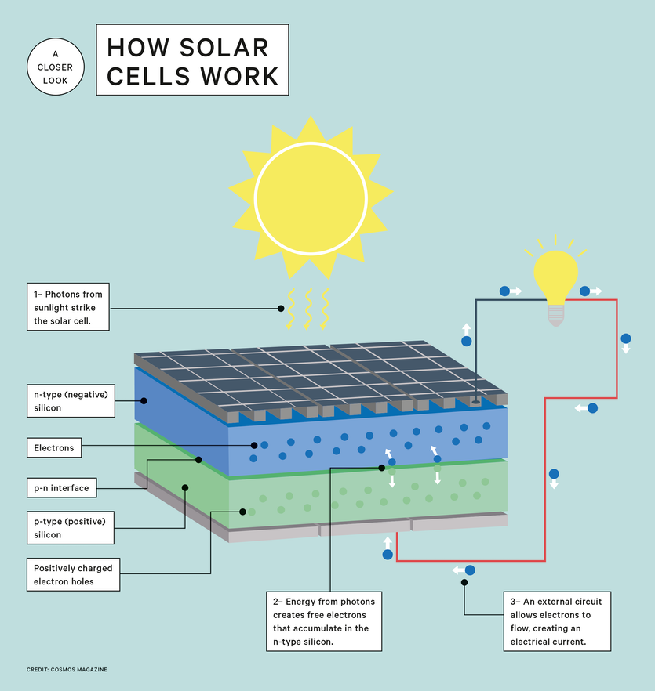

Slide 6
Solar power extraction using PV-Cells
Solar power extraction is the process of converting sunlight into usable electrical energy using Photovoltaic (PV) cells. PV cells are semiconductor devices (usually silicon) that directly convert light energy into electrical energy through the photovoltaic effect.
Structure of a PV Cell
A basic PV cell consists of:
P-type semiconductor layer
N-type semiconductor layer
PN junction (creates an internal electric field)
Front metal contacts (collect electrons)
Back contact
Anti-reflective coating (improves light absorption)

Slide 7
Solar power extraction using PV-Cells
Working Principle: The Photovoltaic Effect
When sunlight strikes the PV cell:
Step 1: Light Absorption
Photons from sunlight hit the semiconductor material.
If photon energy ≥ bandgap energy, electrons are excited from the valence band to the conduction band.
This creates electron–hole pairs.
Step 2: Charge Separation
At the p–n junction, there is a built-in electric field that automatically separates the charges:
Electrons move toward the n-type layer
Holes move toward the p-type layer
This prevents recombination.

Slide 8
Solar power extraction using PV-Cells
Step 3: Current Flow
External metallic contacts allow electrons to flow through a load (bulb, battery, inverter).
This flow of electrons is electric current (DC power).
After passing through the load, electrons return to the p-type layer through the back metal contact, completing the circuit and allowing continuous current flow as long as light is present.
Step 4: Power Generation
The PV cell generates:
Voltage (typically ~0.5–0.6 V per silicon cell)
Current depending on sunlight intensity
Multiple cells are connected in:
Series → increases voltage
Parallel → increases current
This forms PV modules and PV arrays.

Slide 9
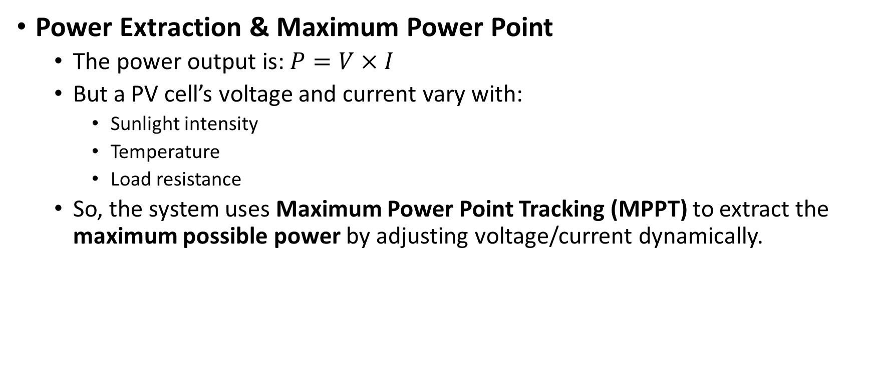
Solar power extraction using PV-Cells
Power Extraction & Maximum Power Point
The power output is: $P=V×I$
But a PV cell’s voltage and current vary with:
Sunlight intensity
Temperature
Load resistance
So, the system uses Maximum Power Point Tracking (MPPT) to extract the maximum possible power by adjusting voltage/current dynamically.

Slide 10
Solar power extraction using PV-Cells
Components of a Solar Power Extraction System
PV Panels – produce DC electricity
MPPT Charge Controller – optimizes power extraction
Battery Storage (optional) – stores power
Inverter – converts DC to AC for home/industrial use
Load – appliances, grid, etc.

